Slide 1






TETU APP
DolphinGroup
Notes, reading & resources management
Knowledge at your fingertips

Slide 2
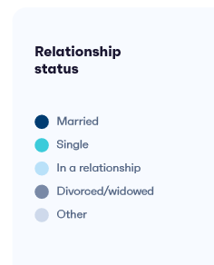


AGENDA
Startup Introduction
Meet the team
Problems & Solutions
Market Research
Survey report
Market understanding
Customer segmentation
Business Model
Financial Projection
Business forecast
Fundraising
Startup valuation
Capital plan
Executive Summary
Q & A

Slide 3






Our team
Dang Loc CEO - Project Manager
Phuoc Tung CTO
Quoc Tuan Developer
Vi Khang Developer
Thu Huong Marketing, Business Planner
Vi Triet Product Designer

Slide 4



Introduce Our Startup
Brand
DolphinGroup
Product
Tagline
Knowledge at your fingertips
Criteria
Lean, Rapid, Personalized, Convenient
God of the knowledge, writing in Egyptian mythology
Strategy
Customer-centric
Tetu is a comprehensive learning tool that caters to individuals of all ages and backgrounds. With its innovative technology and engaging content, Tetu aims to transform the learning experience for its users.
Notes:
God of the knowledge, wisdom, writing, science in ancient Egyptian mythology

Slide 5
Vision, Mission & Team’s culture
Our Vision
Positively impact people's behavior and study habits, and become top providers of effective working and learning digital solutions.
Driven by our spirit
Innovate
Enjoy
Compact
Our Mission
To empower the "rapid and lean" concept. To provide a comprehensive & user-friendly learning platform, Tetu, that incorporates innovative technology, interactive features, and engaging content to enhance the learning experience and foster continuous development.
ICARE
Reliable
Active

Slide 6

Problems
Inefficient note-taking and organization
One app to read files and another to take note, notes are stored distributedly
Lack of a personalized learning experience
“
Many documents are in digital asset form
Read lots of separate resources
Diffuse ways of learning language through articles
Demand to take note and easily review
Resources is unsynchronous make learning process cannot meet user needs
”
Time-consuming and boring learning process
Lots of time to figure out how to manage learning material
Inability to track progress and measure results
Traditional revision methods make it hard to evaluate the learning journey.

Slide 7
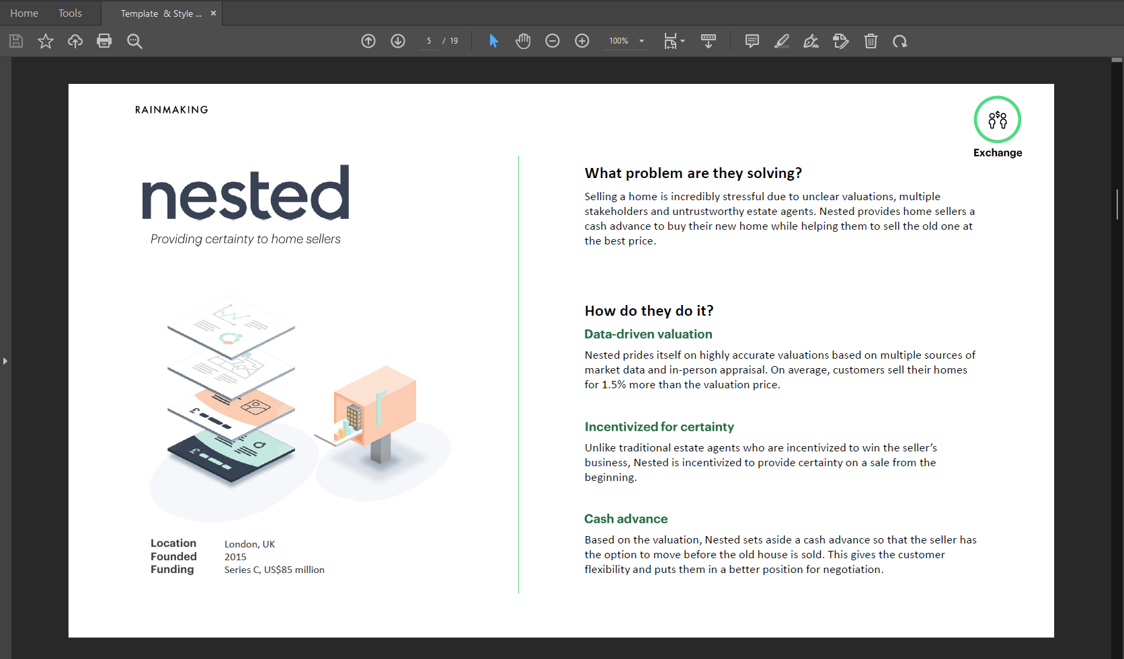
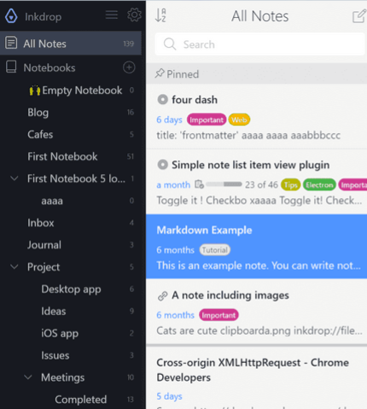
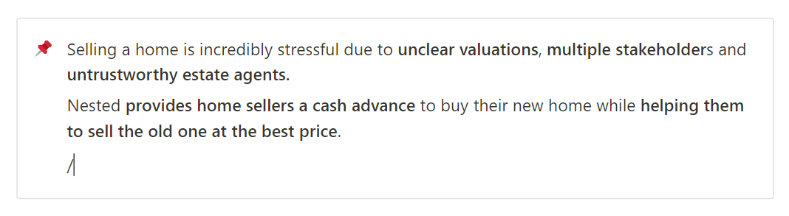
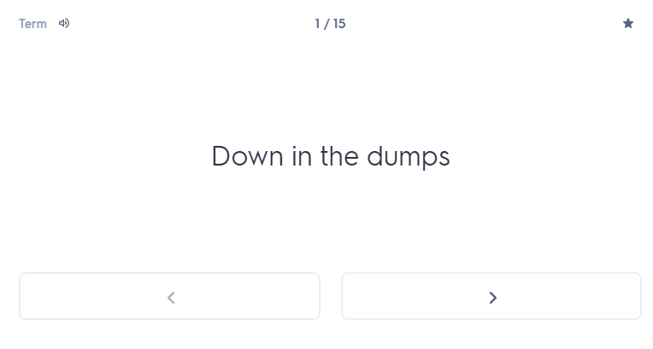
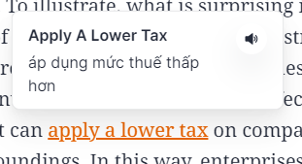
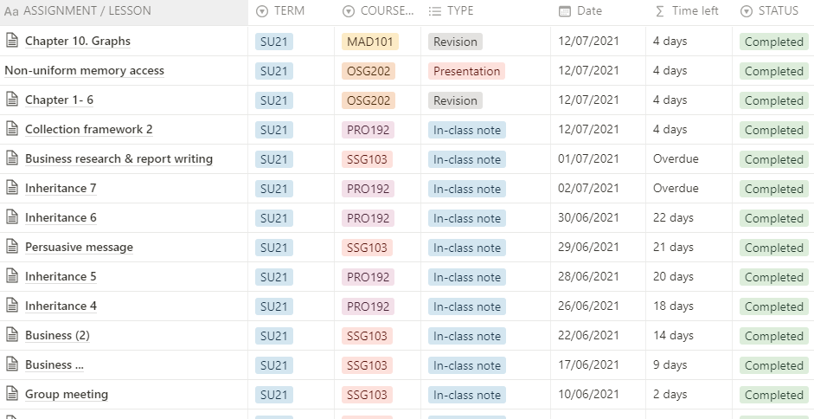
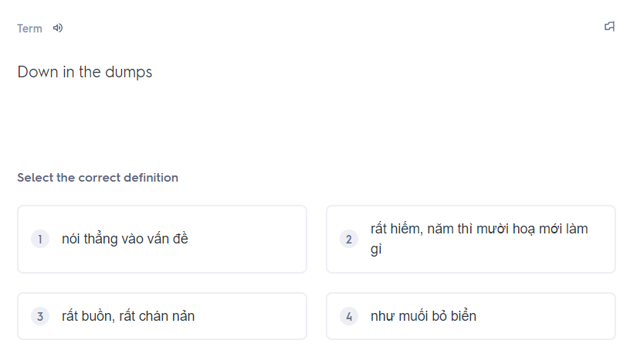
Solutions
Build a cross-platform app that is able to
1. Read document files
2. Take note in app with powerful editor
3. Organize user’s notes
Lean
Personalized
6. Store vocabs and revision
Rapid
Convenient
5. Learn a vocab
4. Intergrate with other tools

Slide 8




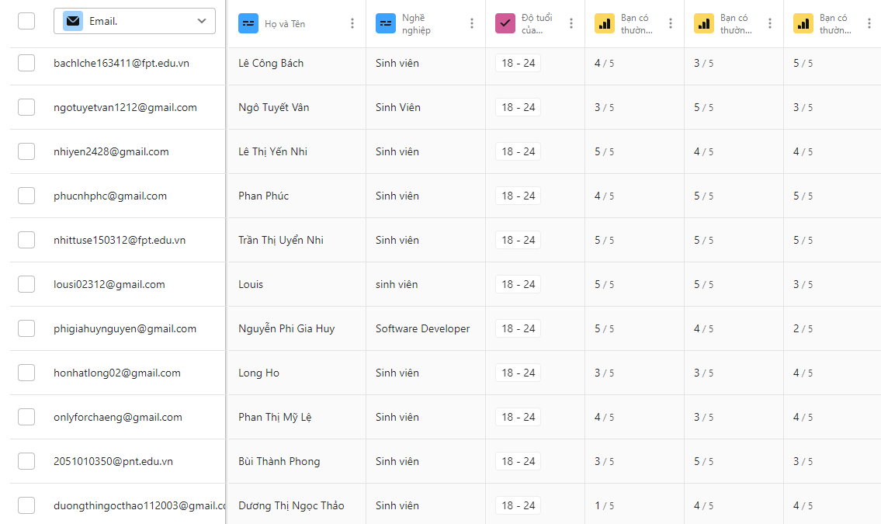
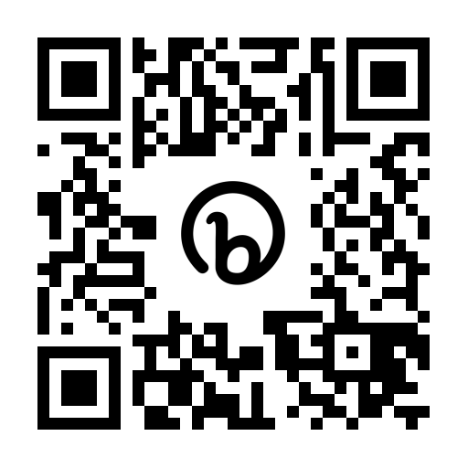
Survey Report
Total views
Total Submissions
Valid Submissions
Completion rate
314
126
116
58.6%
bit.ly/tetu_report

Slide 9
Note-taking habits & overwhelming problems
Self-assessment of process effectiveness
Note-taking demand
Feeling overwhelmed
Traditional
Most painpoints
5.2%
Lots of movement & devices to deal with
46.6%
Digital
4.2
Hybrid
22.4%
5
Managing & retrieving notes
44%
72.4%
Lack of formatting & visualizing abilities in notes
42.2%
Note-taking methods
The need of an optimal learning process solution
Tetu survey report

Slide 10






Preliminary conclusion
Extensively reading and jotting down
Leverage both physical and digital method
Great interest in personal productivity
“
Avid learners with balanced note-taking methods
and moderate-high interest.
Demand for a all-in-one yet simple solution
Impact factors when choosing an app
User interface
”
Synchrony, connectivity
Cost
Personalization
Organization level

Slide 11




Customer Understanding
Behaviours
Difficulties
Read books, do research on favorite topics Use PDF reader, take notes in Word
Have to tab back and forth
Manage pages and distributed notes
Mrs. Minh Hue Ng
Needs
FPT University lecturer
- Offline support, auto sync when connected
- Auto save page info, author, etc., when highlighting
Master in Theory and History of Art - HCM University of Fine Art
“I want an app that can take notes directly on PDFs and output a summary page.”
Behaviours
Difficulties
Read university materials (thousands of pages)
Use tablet to read file, take notes directly on it
Lots of resources to manage
Low speed when taking note by typing
Low productivity when it come to Macbook, Iphone
Ms. Bich Ngoc
Needs
Former Partnership Intern at Amanotes
- New way to interact and note when have to use laptop
Freshman at Miami University
“I feel that the current process is smooth and effective,
I appreciate writing notes by hand whether on paper or on a tablet.”

Slide 12
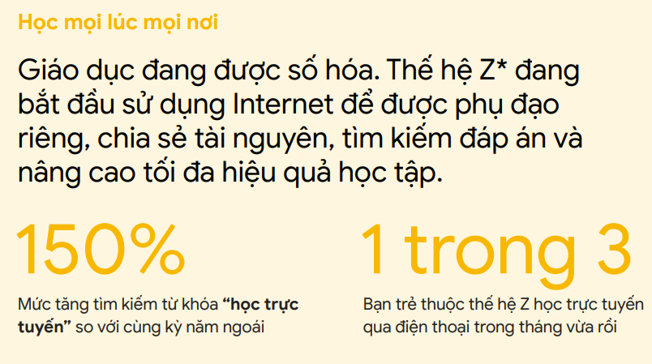
Market Understanding
Market size
in US$ Billion
Learning aid
Document reader
Note-taking
Wiki
CAGR 16.4%
Knowledge base platform
Document collaborator
Personal information manager
“A second brain for you, forever”
3.21 (IAP) + 0.15 (Paid app) + 5.91 (Advertising)
Demand-side economy
Key Players
Google (US)
Apple (US)
Microsoft (US)
Evernote (US)
Notion (US)
Milanote (Australia)
Dropbox (US)
Typora (China)
No restrictions on law or government
Global scope development potential
Vietnam’s Search for Tomorrow – Google Vietnam
Note Taking App Market - Global Industry Analysis and Forecast (2022-2029) - MMR

Slide 13




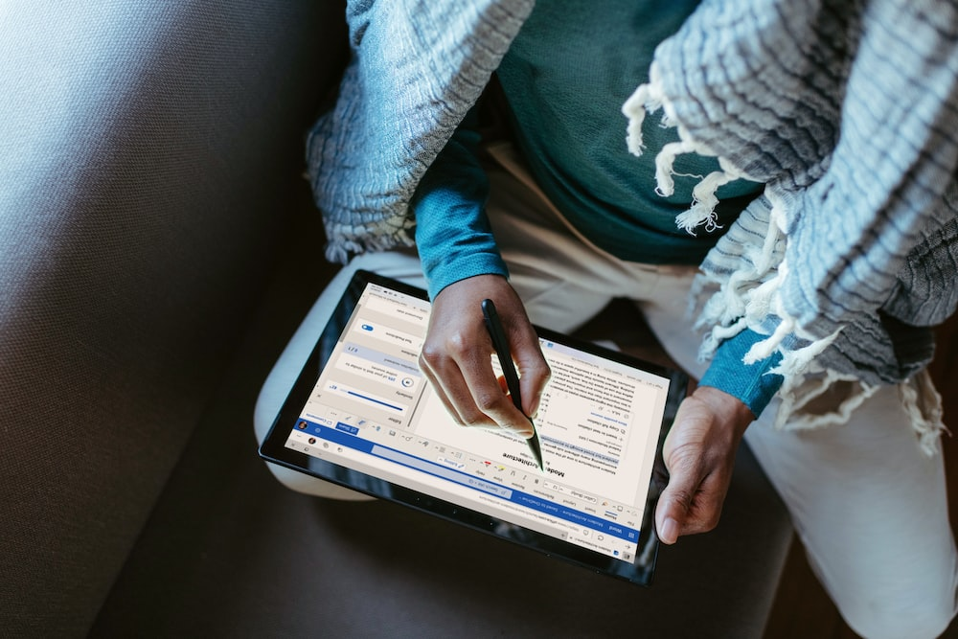








Market Trend
Modularize into minor domain
Phygital reality
Physical and digital world collide
Read
Meeting
Share images
Emerging productivity apps
Craving convenience
“Time is most precious”
From always-available to pre-planned experiences
Top 10 global consumers trends in 2021 - Euromonitor International

Slide 14

Market Demand
Figuring out a workflow
Difficulties in
Working process
Using support tool
They need a solution that
Easy to use, easy to learn
Time efficiency
Cost efficiency
Offline support
Sustainable process

Slide 15




Customer Segmentation
Hobby Learner – 24%
Reluctant Learner – 17%
Traditional learner
Career learner – 19%
Skeptical learner - 15%
High school/University student, 18 – 24 year-olds
Researcher, Scientist, Writer, Engineer, Blogger, etc.
Behaviours
Prefer reading and listening over group study
The architect
The gardener
The librarian
25%
Customization
Build their own
Love discovering
Connect ideas
Arrange neatly
Store & find later
Traditional, Career learners with Gardener and Librarian personalities are target customers
Getting to know today's learners through segmentation - pearson.com

Slide 16









Competitors Note-taking domain
 | Notion | Obsidian | Evernote | GoodNotes | Tetu
Price | Freemium (8$) | Free | Freemium (1.5$) | $7.99 | Freemium (0.6$)
Market share | 73.48% | - | 0.5% | - | -
Platforms
Offline support
Work online (free)
Organization level | High, linear | High, non-linear | Limited, linear | Medium, linear | High, non-linear
Customization level | High | High | Low | Medium | High
Total visits | 429.3M | 4.0M | 28.3M | 1.4M | -
Community | 1M+ | 100K+ | 706K+ | - | -
Addressing the limitations of existing apps while providing ease of use, convenience, and an affordable price would be TETU's USP.
SimilarWebs.com

Slide 17

SWOT analysis
Strengths | Weakness
- New, unique idea, meeting a popular painpoint today - Productivity topic is getting more and more popular - Many sample business model/apps for research and reference | - Limited technical expertise to implement - Lack of connections with industry experts
Oppounities | Threats
- Innovation trend is being promoted by the state and enterprises - Global product potential - Strong market demand for personal work solutions | - Many users have formed habits and are loyal to a number of previous app - The user community of exist apps are substantial and devoted
Focus on our USPs and utilize digital marketing to spread quickly at the initial stage.

Slide 18
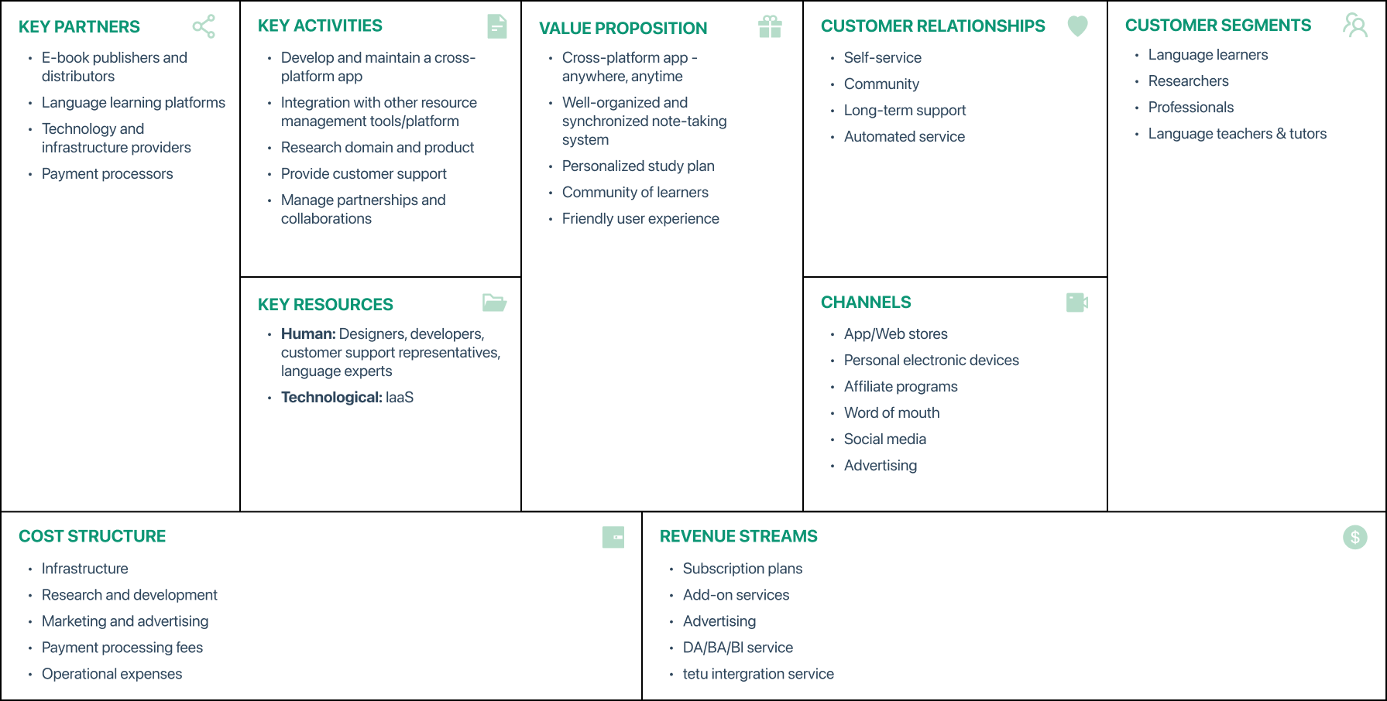
Business Model Canvas

Slide 19
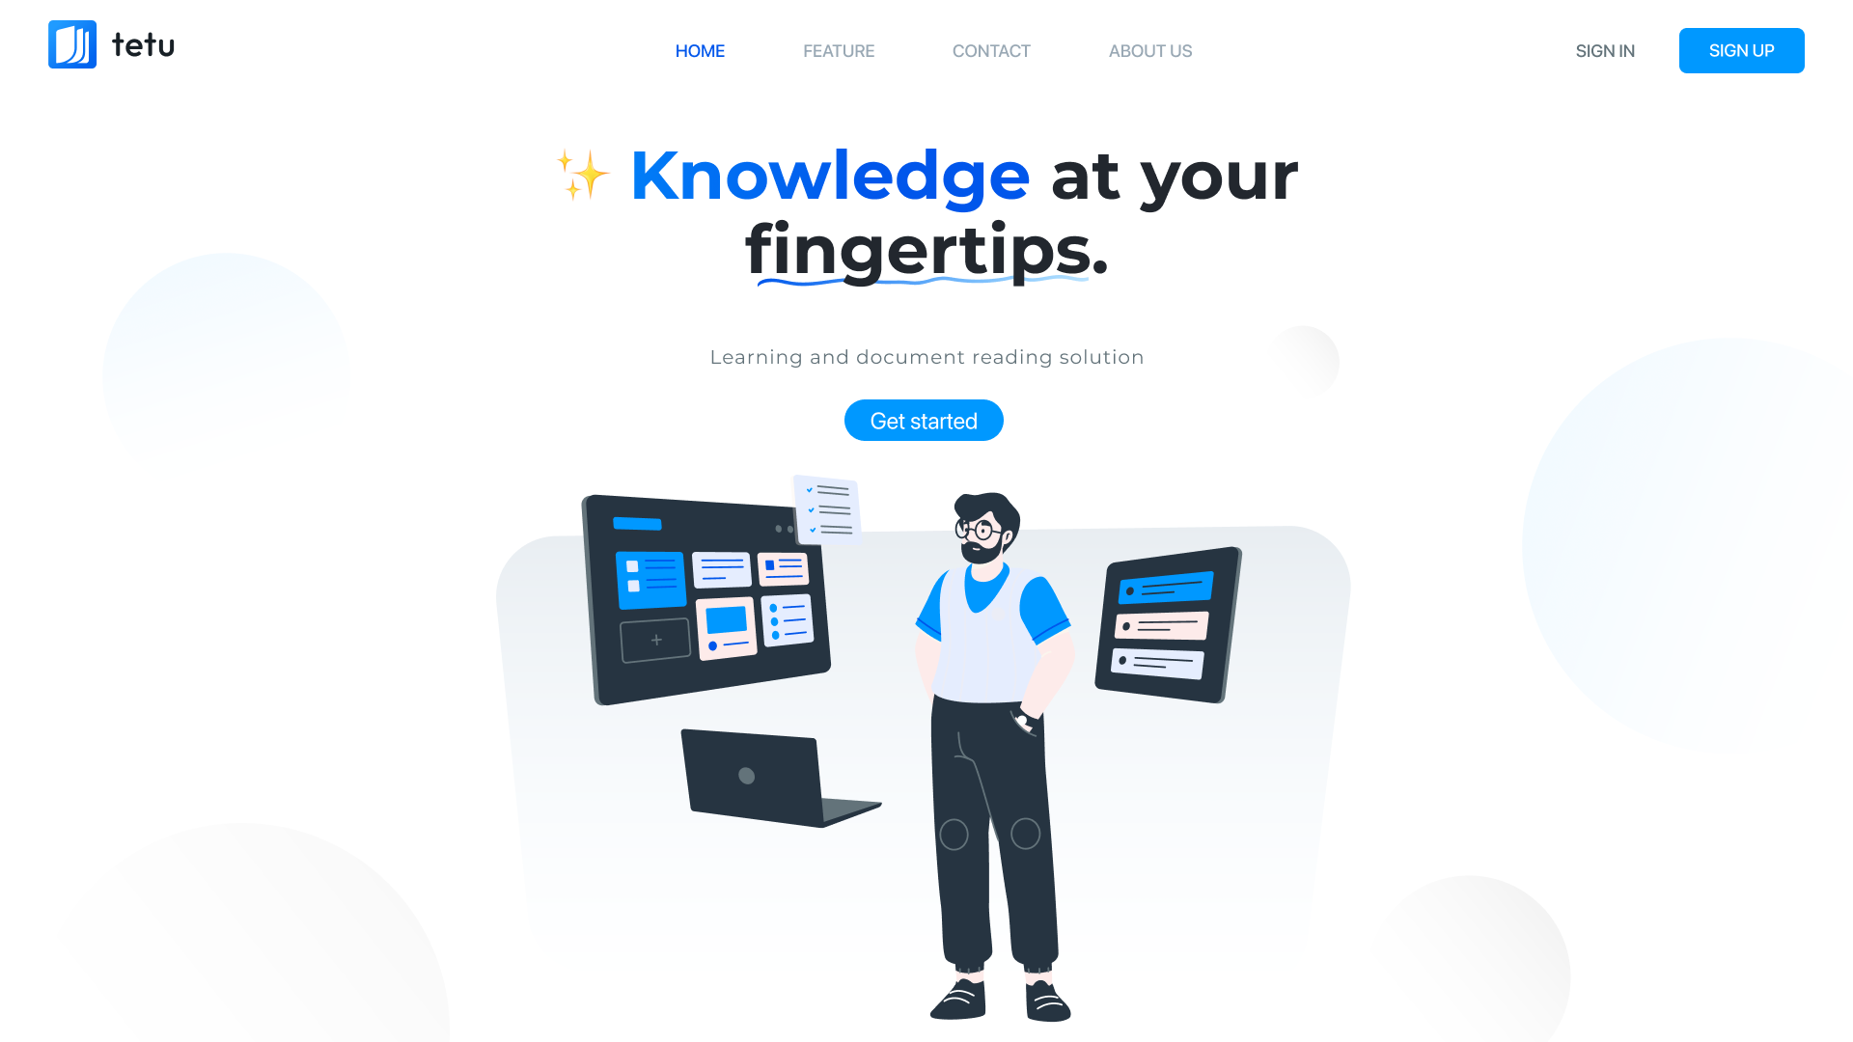
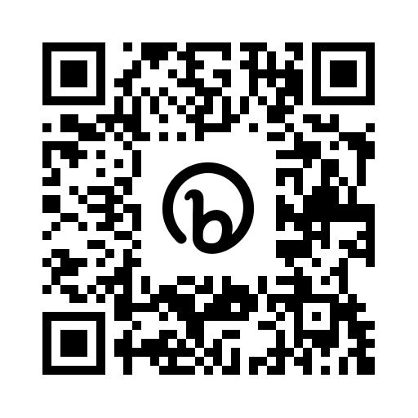
Product Prototype
bit.ly/tetu_app_design

Slide 20
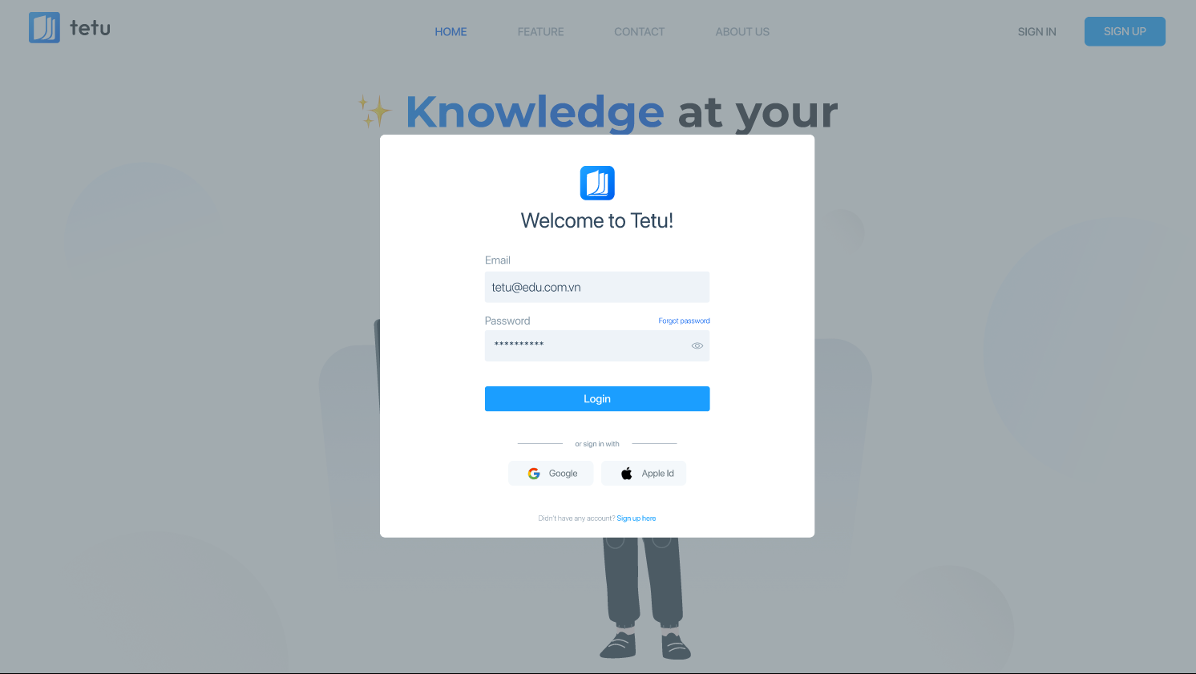
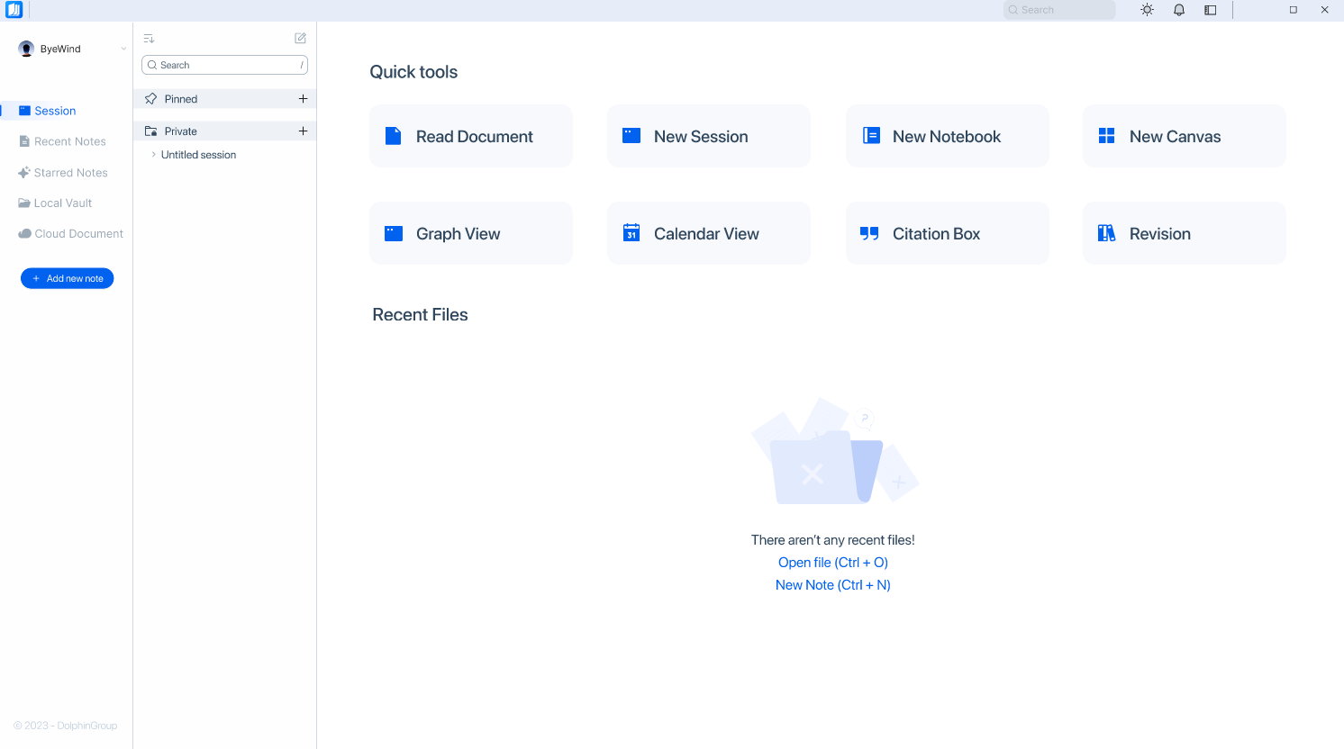
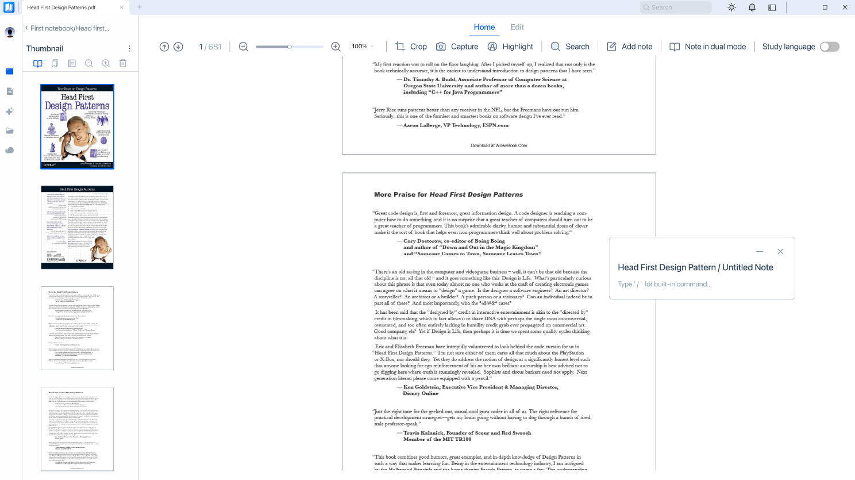
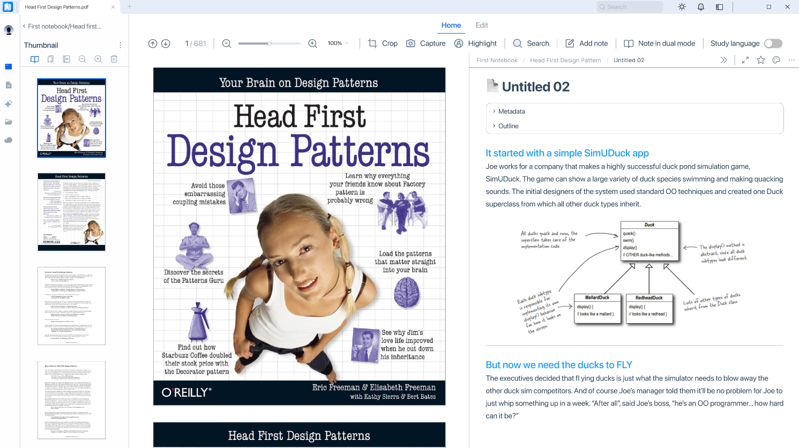
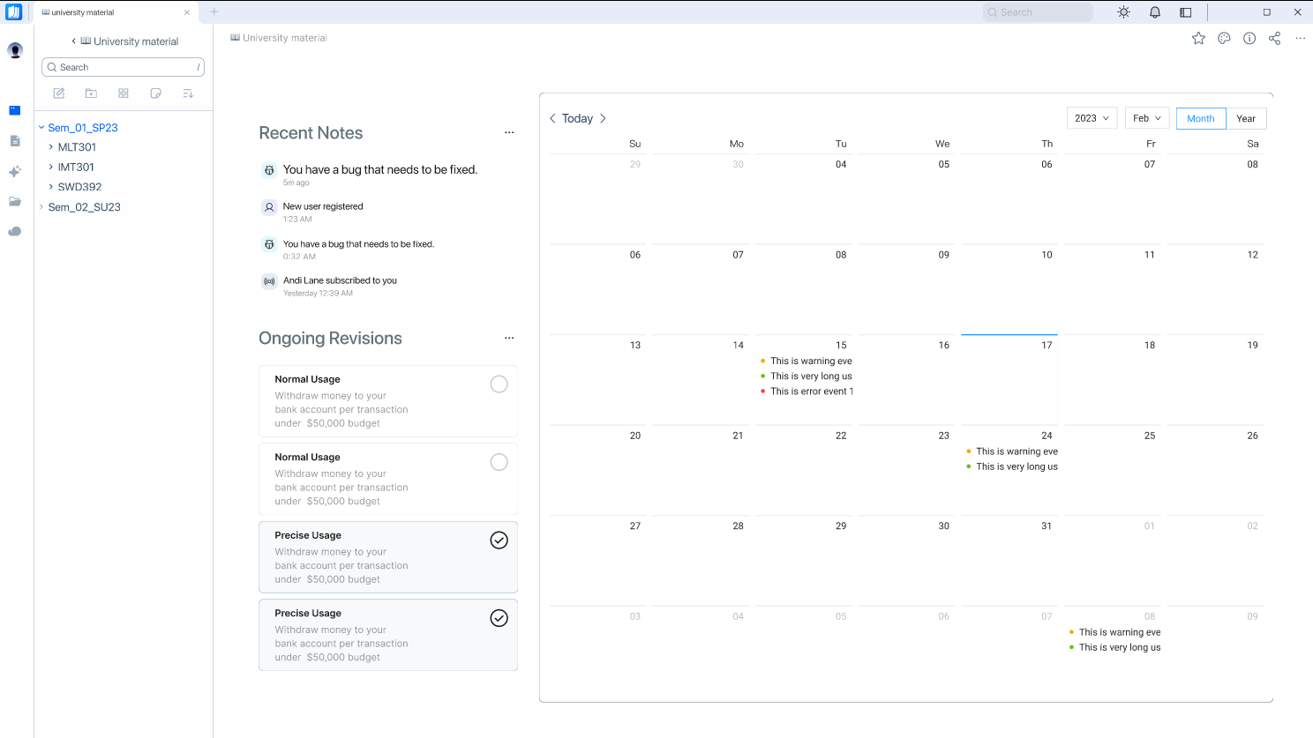
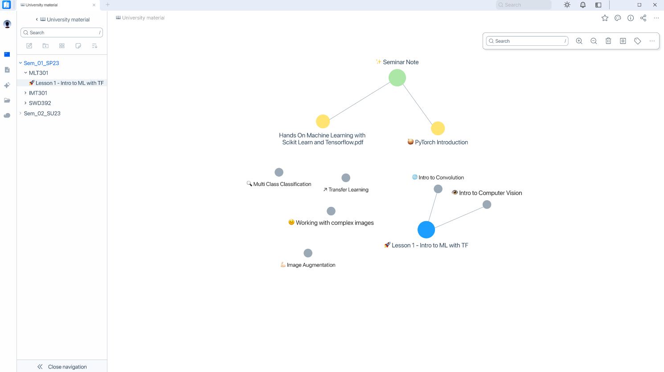
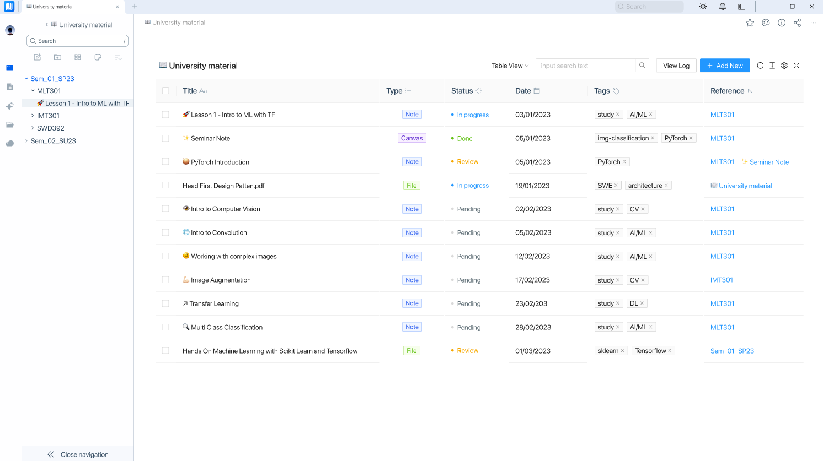
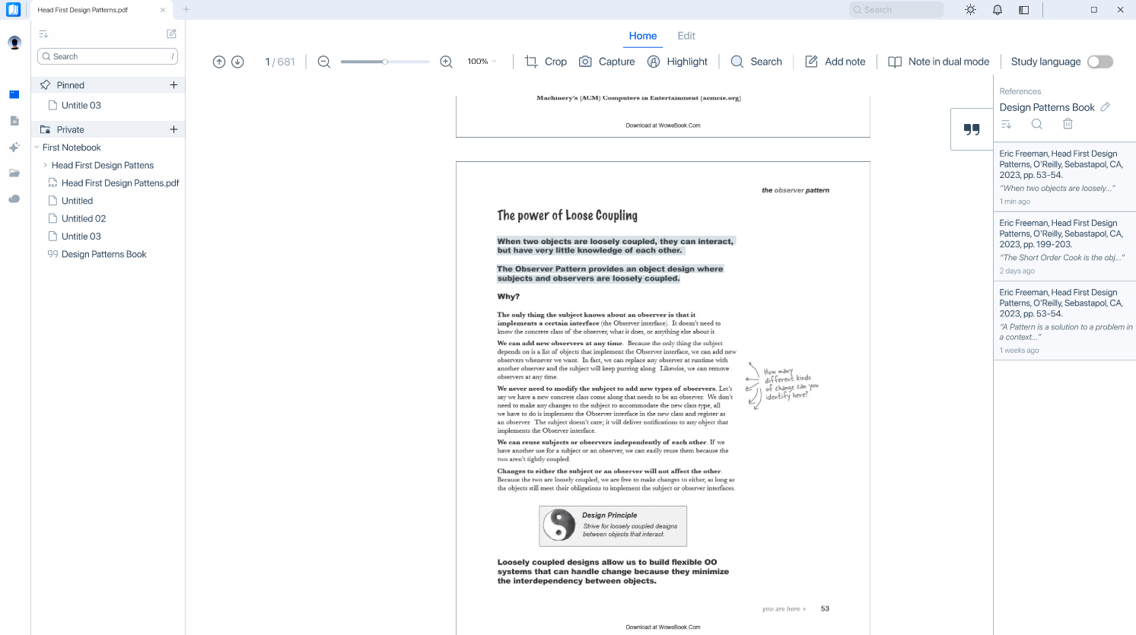
Main features
Read document and take note
Login
Homepage
Take note on-the-fly
Dual-mode note
Calendar-view mode
Graph-view mode
Table-view mode
Citation

Slide 21
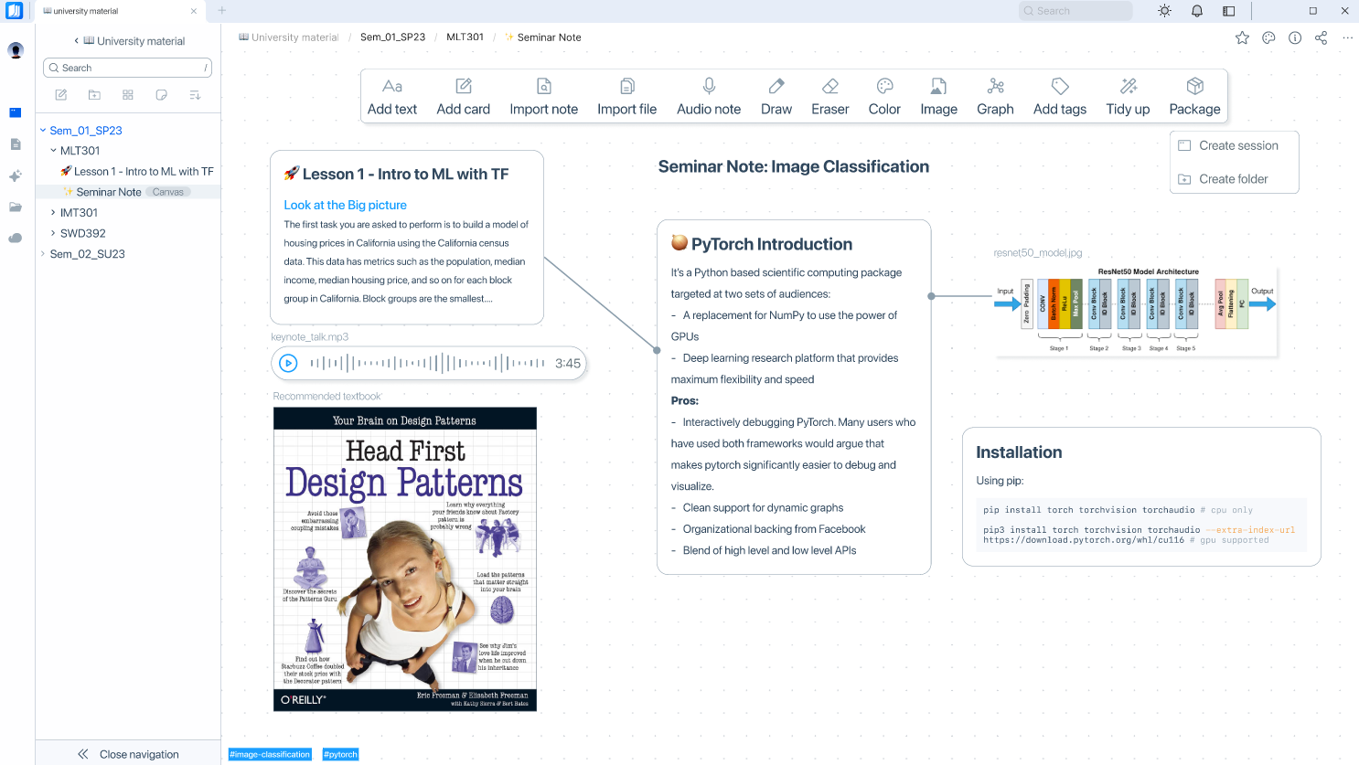
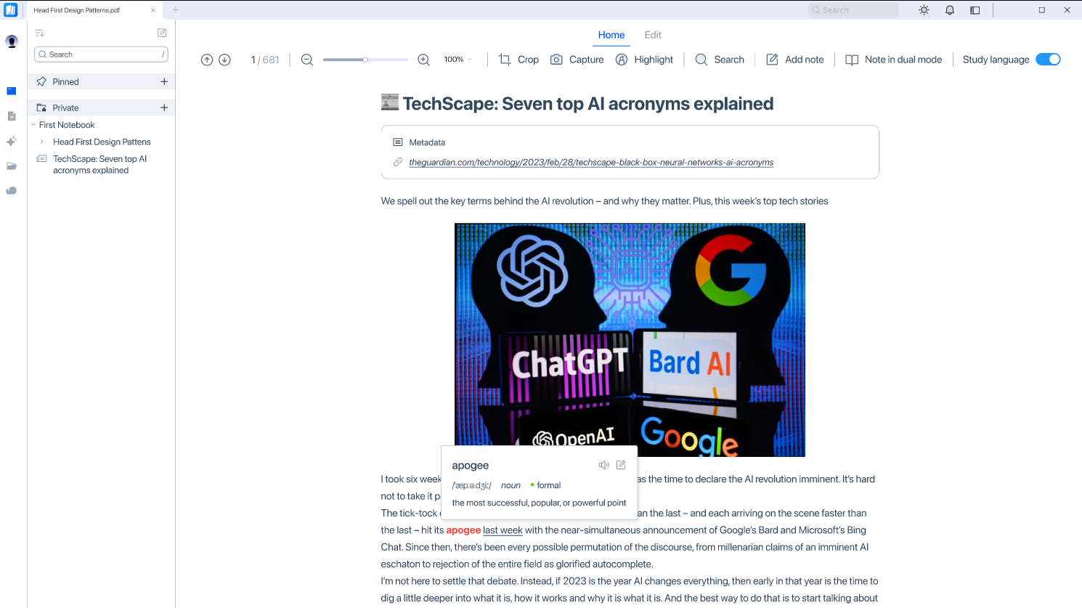
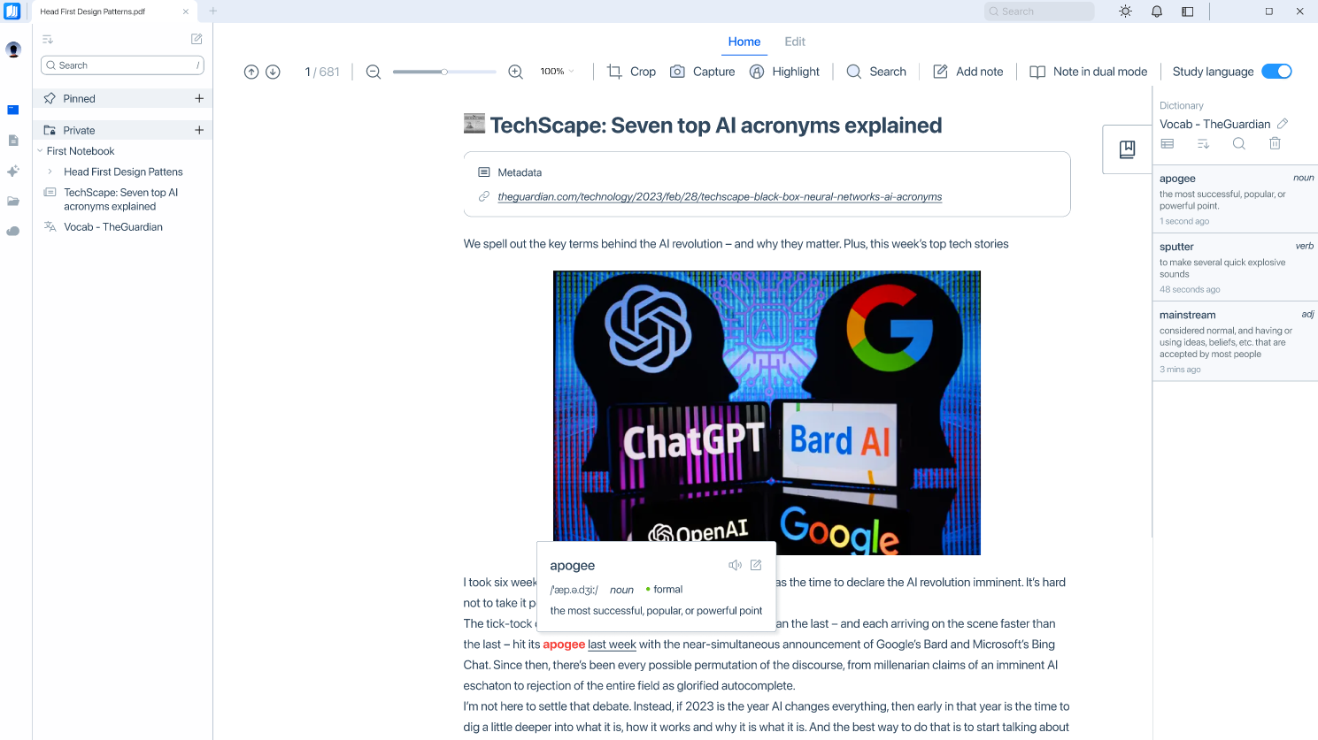
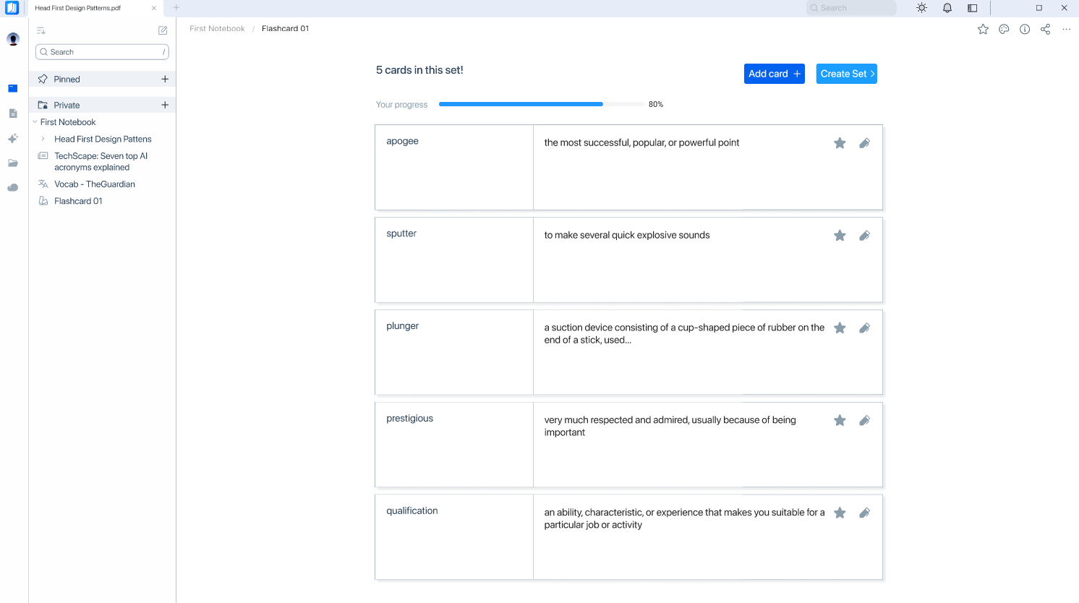
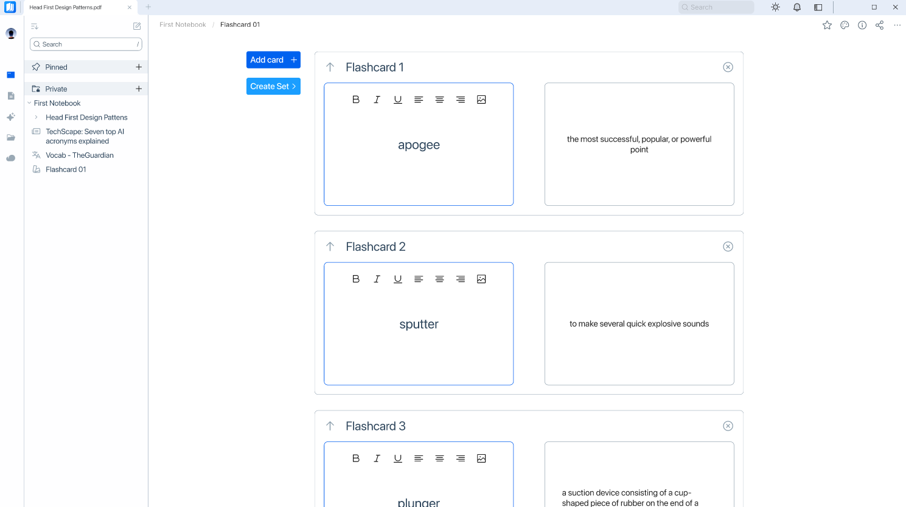
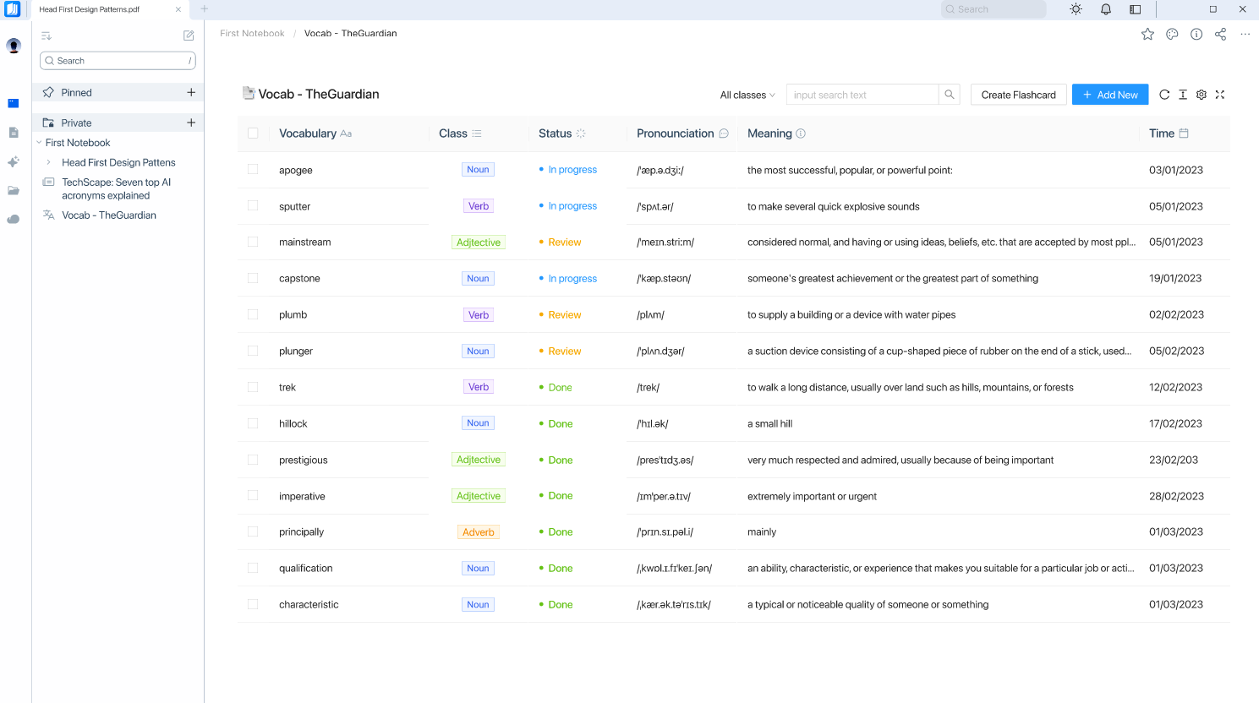
Main features
Canvas view. Read articles and learn languages
Canvas View
Read online articles
Learn words, put into notebook
Learning session
Turn into flashcard
Word list (table view)

Slide 22
Marketing Plan
AWARENESS
ENGAGEMENT
CONVERSION
Timeline
3 months
6 months
4 months
Campaign Objective
Aim to generate 500,000 impressions on social media.
Increase website visits by 20% and achieve an engagement rate of 5% on social media posts.
Gain 10,000 followers on Instagram within the first two months of the campaign.
Generate at least 50 comments and 100 shares on each post within the engagement phase.
Achieve a 90% customer retention rate within the engagement phase.
Achieve a 4.5-star rating on review websites and social media platforms.
Generate $50,000 in revenue within the conversion phase.
Achieve a 5% conversion rate within the conversion phase.
Achieve a 20% increase in email subscribers within the conversion phase.
Final Objective
Achieve a 4.5 star rating or higher on both the App Store and Google Play within 6 months
Increase TETU’s monthly recurring revenue to $100,000 within 12 months
Reach 100,000 paid subscribers within 18 months
Media Touchpoint
Social media advertising (paid ads, influencer, social media posts)
Content marketing (blog posts, guest articles, infographics)
Email marketing (newsletters, promotional emails)
Social media engagement (responding to comments, running contests and giveaways)
App store optimization (improving app visibility and reviews)
Content marketing (webinars, podcasts, how-to guides)
Conversion rate optimization (optimizing the user journey and checkout process)
Referral program (encouraging existing users to refer others to Tetu)
Targeted advertising (using data analytics to identify and target high-intent users)

Slide 23
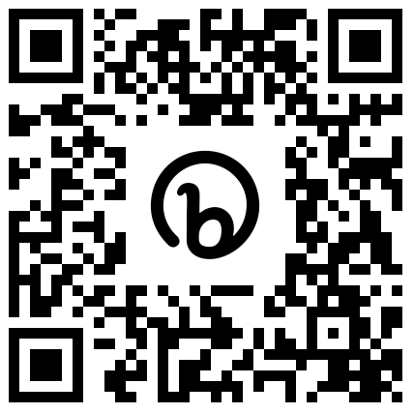
Business Forecast
Assumptions for April 2023 – December 2025
Total loans | 3,500,000,000đ
Interest rate (yearly) | 6.5% | BIDV's business loan interest rate
Total monthly salary | 30%
Total monthly marketing | 20%
Total partnering expense | 0%
Web/app upgrading, IT infra, maintenance, etc. | 40% | AWS service fees and deployment fees
Other expenses | 10% | Meeting & sharing event, coworking space, bonding activities, etc.
bit.ly/tetu_biz_forecast

Slide 24
Financial Plan Summary
 | 2023 |  | 2024 |  | 2025
 | 04-06 | 07-12 | 01-06 | 07-12 | 01-06 | 07-12
Monthly users' growth rate | 12.5% |  | 13.5% |  | 14.5%
New users/month | 5,086 | 17,552 | 33,714 | 72,075 | 155,591 | 350,604
Net accumulative uesrs (including churn) | 5,086 | 22,638 | 33,714 | 105,788 | 155,591 | 506,196
Monthly fees/users | 10,000 | 10,000 | 12,500 |  | 15,000
Monthly subscription revenue | - | 130,137,013 | 421,422,168 | 900,933,107 | 2,333,865,360 | 5,259,067,174
Total revenue | 130,137,013 |  | 1,322,355,276 |  | 7,592,932,533
COGS | - | - | - | - | -
Gross profit | - | 130,137,013 | 421,422,168 | 900,933,107 | 2,333,865,360 | 5,259,067,174
Less expenses, in which
Marketing | 120,000,000 | 240,000,000 | 300,000,000 | 300,000,000 | 420,000,000 | 420,000,000
Salaries | 120,000,000 | 280,000,000 | 300,000,000 | 300,000,000 | 480,000,000 | 480,000,000
Web upgrade, maintenance, IT support, etc. | 240,000,000 | 480,000,000 | 600,000,000 | 600,000,000 | 720,000,000 | 720,000,000
Other expenses | 15,000,000 | 30,000,000 | 42,000,000 | 42,000,000 | 60,000,000 | 60,000,000
Acc expenses | 495,000,000 | 1,030,000,000 | 1,242,000,000 | 1,242,000,000 | 1,680,000,000 | 1,680,000,000
Total expenses | 1,525,000,000 |  | 2,484,000,000 |  | 3,360,000,000
Earning before interest and tax (EBIT) | (495,000,000) | (899,862,987) | (820,577,832) | (341,066,893) | 653,865,360 | 3,579,067,174
Interest expenses | 18,958,333
Net profit | (551,875,000) | (1,013,612,987) | (934,327,832) | (454,816,893) | 540,115,360 | 3,465,317,174
Total net profit | (1,565,487,987) |  | (1,389,144,724) |  | 4,005,432,533

Slide 25
Business Forecast Consolidation
 | 2023 | 2024 | 2025
Revenue | 130,137,013 | 1,322,355,276 | 7,592,932,533
COGS | - | - | -
Gross profit | 130,137,013 | 1,322,355,276 | 7,592,932,533
Gross profit margin (%) | 100 % | 100 % | 100 %
Less expense, in which
Marketing | 360,000,000 | 600,000,000 | 840,000,000
Salaries | 400,000,000 | 600,000,000 | 960,000,000
Rent | - | - | -
Partnering | - | - | -
Web upgrade, IT infra, maintenance, etc | 720,000,000 | 1,200,000,000 | 1,440,000,000
Orther expense | 45,000,000 | 84,000,000 | 120,000,000
Total expense | 1,525,000,000 | 2,484,000,000 | 3,360,000,000
EBIT | (1,394,862,987) | (1,161,644,724) | 4,232,932,533
EBIT margin (%) | (1,072)% | (88)% | 56 %
Interest expense | 170,625,000 | 227,500,000 | 227,500,000
Net profit | (1,565,487,987) | (1,389,144,724) | 4,005,432,533
Net profit margin (%) | (1,203)% | (105)% | 53 %
Monthly new users | 22,638 | 105,788 | 506,196
Monthly subscription revenue | 130,137,013 | 1,322,355,276 | 7,592,932,533
CAC | 15,902 | 5,672 | 1,659
NPV |  | 10% | 438,116,358
IRR |  | 10% | 22%
NPV is > 0, IRR > benchmark 10%
Until the end of 2024 will still suffer losses.
Decreasing costs
Increasing revenue, users
Opportunities for development & gain more profit in the next periods

Slide 26
Break-even Point
 | Total Revenue (VND) | Total Expense (VND)
06-2023 | 0 | 495,000,00
12-2023 | 130,137,013 | 1,525,000,000
06-2024 | 551,559,181 | 2,767,000,000
12-2024 | 1,452,492,289 | 4,009,000,000
06-2025 | 3,656,220,636 | 5,689,000,000
12-2025 | 9,045,424,822 | 7,369,000,000
Break-even point after 30 months
BEP at 10-2025, accumulative revenue: 6,290,265,317đ
BEP

Slide 27


Valuation Case Study
 | Notion | Evernote | ClickUp
Launch | 2013 | 2008 | 2017
Users | 1M | 500,000 (2009) | 4M (2021)
Revenue | ~ $11M (2019) | $650,000 | $30M
Valuation | $60M | $80M | $200M
Raised | $18.2M (2019) – Series A | $26M (2009) – Series A | $35M (2020) – Series A
Revenue multiples | ~ 5.5x | ~ 12.5x | ~ 2.67x
crunchbase.com, techcrunch.com & getlatka.com

Slide 28

Startup Valuation
 | ClickUp | Tetu
Launch | 2017 | 2023
Monthly users | over 340k (2021) | Over 70k (2025)
Revenue | $30M | $322,748
Valuation | $200M | $900,000 (~21,303,319,000đ)
Revenue multiples | ~ 2.67 times | ~ 3 times
Shares offer
10%
2,100,000,000 VND
(2 billions, one hundred millions dongs)
Compare with ClickUp figures and consider tetu growth rate

Slide 29
Capital Plan
Fundraised
2,100,000,000đ
Plan for 6 months
Jan – Jun / 2026
 | Weight | Expense | Note
IT infrastructure | 40% | 840,000,000 đ | 100k MAU
Marketing & Customer acquisition | 15% | 315,000,000 đ | Promote digital marketing, ads & KOL booking
Salary | 20% | 420,000,000 đ | Offer competitive salaries to attract and retain talent
Research & development | 10% | 210,000,000 đ | Improve the app's functionality and usability, deveolop advance features
Legal | 5% | 105,000,000 đ | Allocate funds towards hiring legal counsel and consultants
Others | 10% | 210,000,000 đ | Bonding activites, internal events, etc.

Slide 30

THANK YOU!
If you have any questions?
Don’t hesitate to ask
or contact us
dolphin.team111@gmail.com
DolphinGroup

Slide 31

Executive Summary
Problem
Read lots of separate resources
Inefficient note-taking and resources organization
Lack of personalization
Difficulties when reviewing those notes
Target audience
High school/University student
Office worker
Learner
Age: Gen Z – Gen Y
Hobbies: learning, reading, researching
Solution
A hybrid-app can:
+ Read document file and take note in app
+ Organize notes in a structured and coherent manner
+ Create personal notebook to review, track progress and measure results
USP
Built-in note taking and intelligent organizing system
Integration with other tool
Less time-consuming for management
Affordable price
Goal
Positively impact people's behavior and study habits
Improve individual’s productivity, make learning effortless
Become top effective working and learning solution-providers

